Slide 1
9/30 Opener
Please submit chapter one homework questions to the tray on my desk.
1. If you were an author, what would you write about?
2. Why, or how, would you choose your topics or themes?

Slide 2
Objectives
Analyze the purposes for writing, according to George Orwell
Identify reasons why George Orwell wrote “1984” and other literary works.
Critically read and analyze a primary source document.

Slide 3
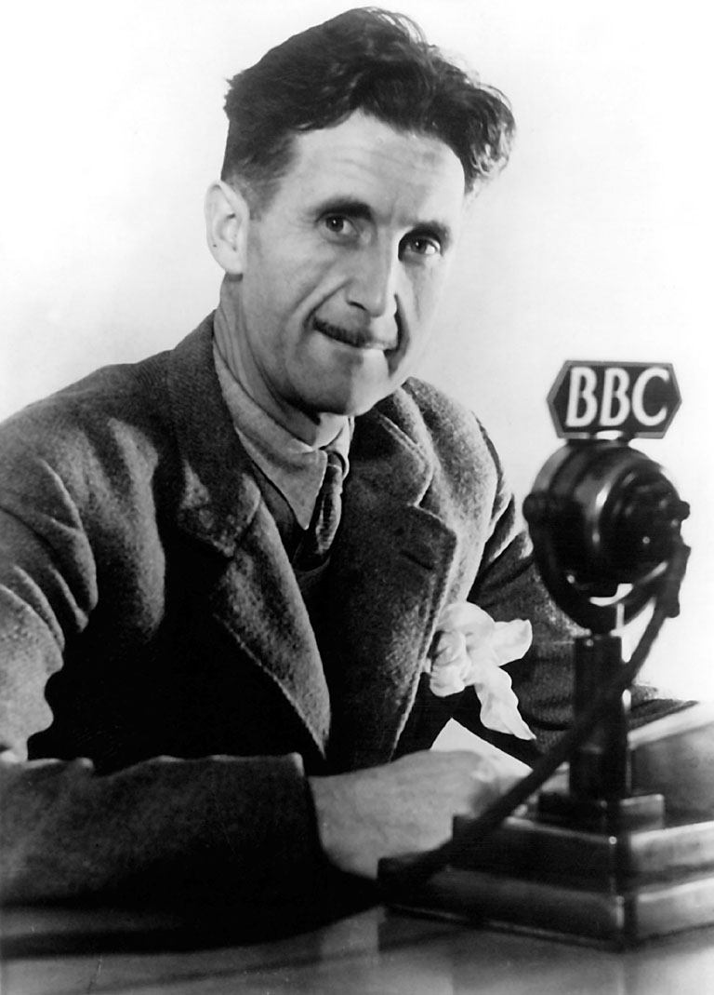
George Orwell (1903-1950)
Key Historical Events:
European Colonialism (Southeast Asia and Africa) 1880’s to 1950’s
Russian Revolution and Rise of Stalin (1918, 1922-1953)
Spanish Civil War 1936-1939)
World War II (1939-1945)
Nuclear Age and Cold War (1945-1950’s)

Slide 4
Why Orwell Wrote: Closure questions
What are the four purposes for writing, according to Orwell?
What was his purpose for writing 1984 and his other works?
Why will his books be “failures?” (his words)
TERMS TO KNOW:
Utopia: an ideal world/place
Dystopia: a world that is supposed to be ideal, but is indeed dysfunctional (1984 is a dystopian novel)

