Slide 1
Welcome to your senior year!
Grab an opener sheet of paper (brown file cabinet) and answer the following questions:
What is my role as a senior at CHS?
2. How do I want teachers/people at CHS to remember me?
3. What are five goals I want to accomplish by the time I graduate?
Notes:
Please answer the questions to the best of your ability.

Slide 2
Objectives and Standards
9/3 Learning objectives
1. Come up with a working definition for the terms “hero” and “traitor.”
2. Formulate an initial opinion on whether Edward Snowden is a hero or a traitor.
3. Describe the procedures for Mr. Fielder’s classroom.
4. Analyze skills necessary to be successful in college and the workplace.
Core Standards addressed:
W.11-12.4: Produce clear and coherent writing in which the development, organization, and style are appropriate to task, purpose, and audience.
W.11-12.9: Draw evidence from literary or informational texts to support analysis, reflection, and research.
Notes:
FYI

Slide 3
Syllabus
Class procedures/dates
http://mrfielderclinton.weebly.com
Google Docs – submit your work through here!!
Notes:
There will be a quiz over class procedures/policies on Friday. Focus on homework/testing policies, as well as the cell phone/electronic device policy. Review the website, as most class materials will be posted there for your review. For google documents, you can log on using your Clinton e-mail address (if you don’t already use Google docs).

Slide 4
Heroes and Traitors
What makes someone a hero? Can you give an example and explain what makes that person a hero?
What makes a person a traitor? Can you give an example and explain what makes that specific person a traitor?
3. Can you give an example of someone who is/has been classified as both?
Notes:
Please answer these and submit via e-mail or google docs.

Slide 5
Edward Snowden: Hero or Traitor
Warning: This media clip is an editorial, meaning it expresses a specific opinion. The opinion expressed is one to be questioned and analyzed!!
http://www.youtube.com/watch?v=blBYz5g_7TM
Notes:
View the following clip to get an idea of the Snowden case and both sides, even though it is editorialized.

Slide 6
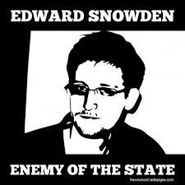
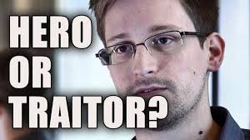
Research
Is Edward Snowden a hero or traitor?

Slide 7
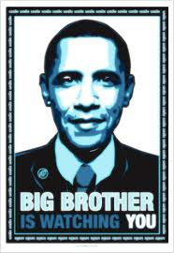
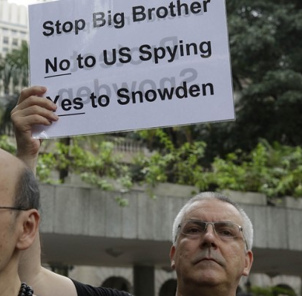
Why Snowden?? 1984
Notes:
There is a clear connection between the contents of our first book, 1984, and the Edward Snowden case.

Slide 8
9/3 Closure/Homework
Initial Thoughts: Is Edward Snowden a Hero or a Traitor?
Homework: Have procedures ½ sheet signed.
Notes:
Please answer.

