Slide 1
Lesson Objectives
1. Define the terms: morals, values, and ethics; differentiate between the three.
2. Students will identify their top five personal values, and explain how values define their decisions when answering ethical questions
3. Utilize personal morals, ethics, and values to evaluate a real-world scenario.
4. Students will evaluate ethical decisions made by peers.

Slide 2
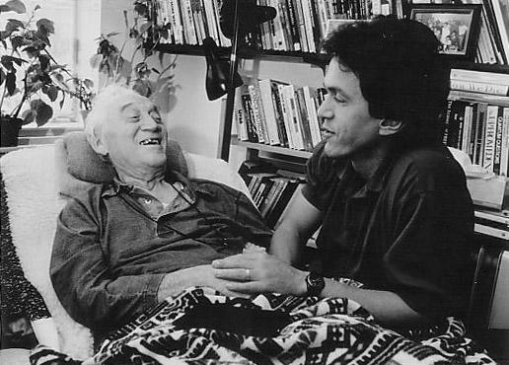
Why??
Why “morals, values and ethics?” I thought this was English class…
They are at the heart of the book Tuesday’s with Morrie.
Morrie, dying of ALS, evaluates the morals and values of Mitch and of our society.
Ethical questions and concerns abound in this book.

Slide 3
What are your core values?
Values (what are they, according to the article?)
Follow the steps 1-5 in the article to identify your five core values.

Slide 4
Morals: Defined
1.A lesson, esp. one concerning what is right or prudent, that can be derived from a story, a piece of information, or an experience.
2.A person's standards of behavior or beliefs concerning what is and is not acceptable for them to do

Slide 5
Ethics: Defined
1.Moral principles that govern a person's or group's behavior.
2.The moral correctness of specified conduct.
So what are the differences between morals and ethics? (Reading/notes)

Slide 6
Ethical Decisions
Ethical Behavior / Decisions
Ethics: right/wrong based on those values (Morals)
Values: What we believe in and what is important
Our VALUES help create our own personal sense of MORALITY.
Our sense of MORALITY defines how we make ETHICAL decisions.

Slide 7
Assignment
Writing: “My Code of Ethics”
Identify the values/moral principals that guide your life. These make up your CODE OF ETHICS
Attitude Trust Work Ethic
Empathy Compassion Integrity
Sacrifice Achievement Faith
Use the “values” document from earlier for more ideas to help you build your code of ethics.
Explain your values/morals that you choose (this creates your Code of Ethics…gives the explanation or “WHY” behind what you write)

