Slide 1

™
Copyright © 2006

Slide 2
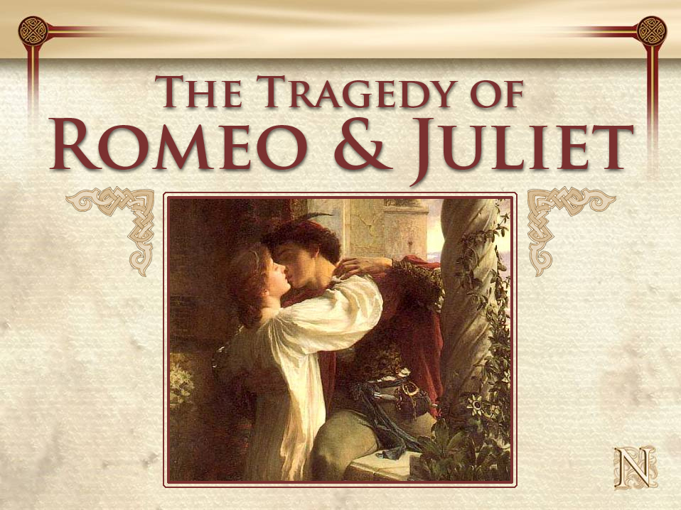

Slide 3
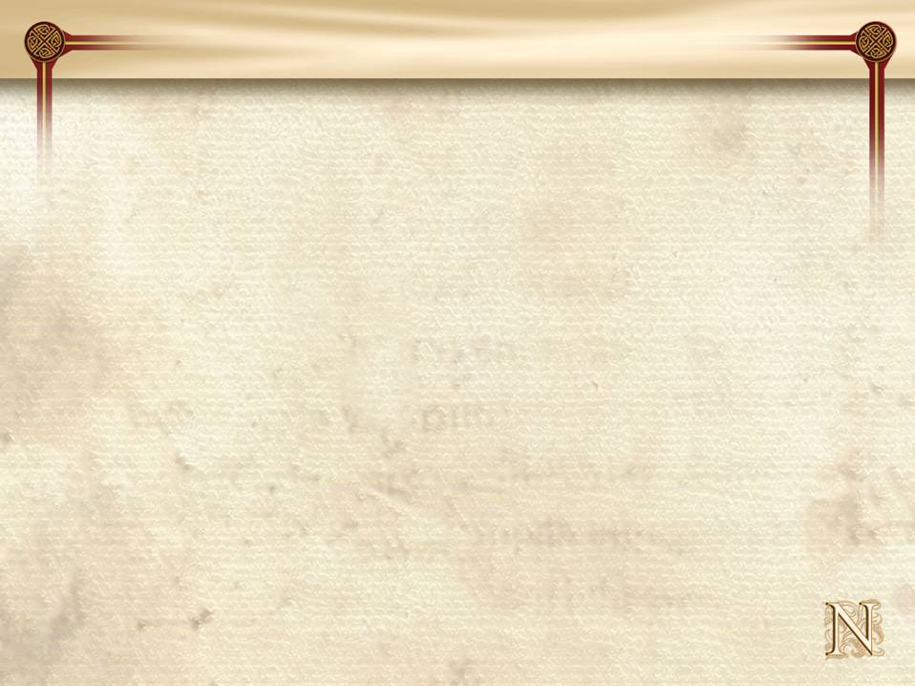

Objectives
Introduce and identify the author of
The Tragedy of Romeo and Juliet
2. Examine historical events
Bloom’s: knowledge, comprehension

Slide 4
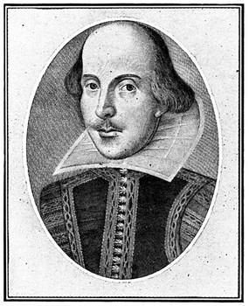
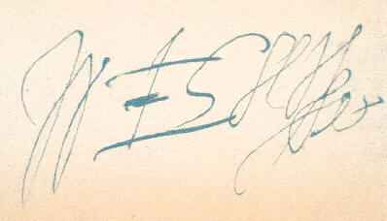
About the Author
Meet the author of
THE TRAGEDY OF
ROMEO & JULIET
William Shakespeare

Slide 5



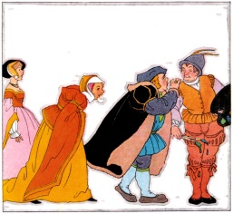
About the Author
Shakespeare was born in Stratford,
England in 1564, but no one knows
the actual day of Shakespeare’s birth!
He wrote 37 plays as well as 154
sonnets, but Shakespeare never
published any of his plays!
Shakespeare is considered the
greatest writer in the English
language.
Surprisingly, Shakespeare's family
was illiterate!
Look at the map.
It gives a good idea
where Stratford is located.
Stratford
London
That is a lot of writing!
Illiterate means they could not read or write! Imagine that!

Slide 6

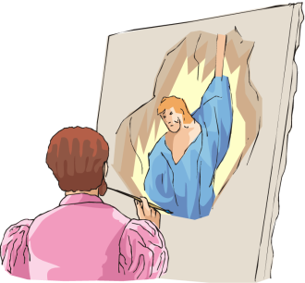
Shakespeare Odds & Ends
There are stories that Shakespeare
fled Stratford because he stole a
deer; he did not want to be
prosecuted.
We really don’t know what
Shakespeare looked like because
his portrait was never painted while
he was alive.
Shakespeare died in 1615.
All of Shakespeare’s grandchildren
died – he had no descendents.
“Doe, a dear, a female dear…”
Why do you think they didn’t
just use a camera?
Let’s see, that made him
only 1, 2, 3… 52!

Slide 7
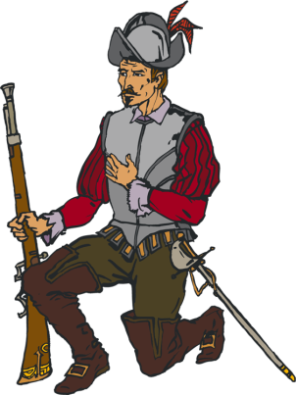

Shakespeare’s England
Queen Elizabeth I (1558-1603) ruled England and helped her country become a leading naval and commercial power in the western world.
Sir Francis Drake sailed his ship around the world and became one of the most popular English sea captains in history.
In the 16th century, London was being transformed. Its population grew 400% during the 1500s, to nearly 200,000 people in the city and outlying areas.
The plague known as the Black Death, which swept through England and Europe, was the major cause of death during this time. This disease was carried by rats living in the streets. Unfortunately, only the very rich were able to afford doctors and many people died.
Queen Elizabeth ruled
England as a single woman
She was really quite amazing!
Some people believe Drake may have dated the Queen!
Some scholars believe that over half the
population of Europe died because of
the plague!

Slide 8



Shakespeare’s England
Other things were also happening…
In 1570 Giambattista della Porta invented the pinhole camera.
The Danish astronomer, Tycho Brahe, was the first to observe a supernova in 1572.
William Lee of England invented the first knitting machine in 1589.
In 1599 the Globe Theater was built.
James VI of Scotland ascended to the English throne after the death of Elizabeth I in 1603.
English settler John Rolfe married Pocahontas in 1614.
A pinhole camera was a camera without a lens. The light producing the image passed through a small hole in order to make a clear image.
Knit one, purl two…
Didn’t John Smith
marry Pocahontas? Maybe it was Will Smith!

Slide 9

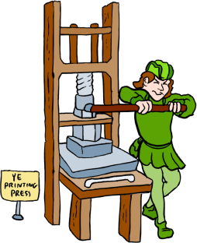
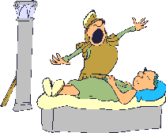
Did You Know?
While no one is sure when The Tragedy of Romeo and Juliet was first performed, it is believed that it was sometime between 1594 and 1595.
Romeo and Juliet was first printed around 1597.
The story of Romeo and Juliet was based on real lovers from Verona who died for each other in the year 1303.
The Capulets and Montagues really did live in Verona.
Boy, that sure was a long, long time ago!
Printed? Does that mean Shakespeare did not know how to write in cursive?
OH NO! You mean this really happened? It wasn’t just some story Shakespeare made up? Now this really is a tragedy!

Slide 10
Comprehension Check
Directions: select the best answer to each question
1. The author of The Tragedy of Romeo and Juliet is
a) Queen Elizabeth b) William Shakespeare c) Romeo
b) William Shakespeare
2. The plague that swept through England was called
a) Black Death b) Red Death c) influenza
a) Black Death
3. Who did the real Pocahontas marry?
a) Will Smith b) John Rolfe c) John Smith
b) John Rolfe

Slide 11
Objectives
1. Examine the Globe Theater
2. Identify Elements of a Play
Bloom’s: knowledge, comprehension, analysis

Slide 12
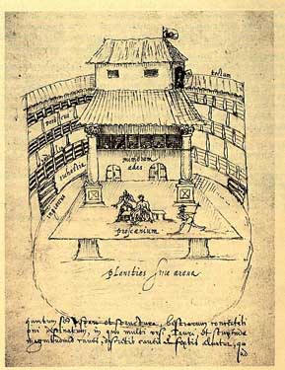
“All the World’s a Stage”
The first Globe Theatre was built in 1599 during the Elizabethan age. It was round shaped with the roof partly covered.
People did not go to plays at night because there was no electricity. The only source of light for the stage was the sun; this is why the middle of the theater was open to the sky.

Slide 13
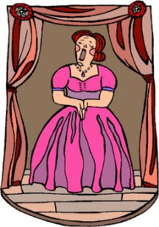



“…And All The Men & Women Merely Players.”
Women and girls were not allowed to act in plays. In the Elizabethan era, it was not socially acceptable for a woman to perform on stage.
Men played the roles of women and young boys played the roles of girls.
In order for the people to know the genre of play being performed, a flag was flown over the theater.
The color of the flag indicated the genre of the play: white stood for comedy, black for tragedy, and red for history.
Could you imagine that happening today?
Remember, actors did not have the respect or the paycheck then, as they do today!
“You’re a grand old flag, you’re a high flying flag…”!

Slide 14
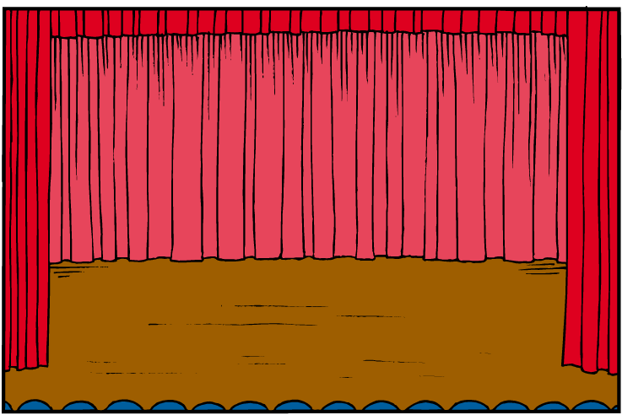



The Play
The Tragedy of Romeo and Juliet is not a book; it is a play. A play shows you the story while a book tells you the story.
Plays were meant to be watched,
not read. To help understand
the play, try to picture in your mind:
a) the character’s actions
b) what they look like
c) how they talk
Just pretend you are right there with the characters; what do you see and hear?
While reading the play, make a list of these characteristics.

Slide 15


Stage Direction
Stage directions tell the actors
when they should be on the stage
and what they should do while on stage.
The directions are easy to find while reading because they are in italics or {brackets}. Stage directions are usually a couple of words like:
{They fight}.
Shakespeare used these stage directions the most:
Enter – someone walks onto the stage
Exit – one person leaves the stage
Exeunt – more than one person leaves
the stage
When reading the play, don’t read the stage directions out loud. Try to visualize the characters following the directions.

Slide 16
Elizabethan English
In order to better understand Shakespeare’s plays play, it is good to understand some of the terminology Shakespeare uses in the writing of his plays. The language is called Elizabethan English, named after Queen Elizabeth the I.
ere ~ the old English word for before
hence ~ the old English word for here
swear’st ~ the old English word for swear
thee, thy, thou ~ are old English words for you
thine ~ the old English word for your
wert ~ the old English word for were
wherefore ~ the old English word for why

Slide 17
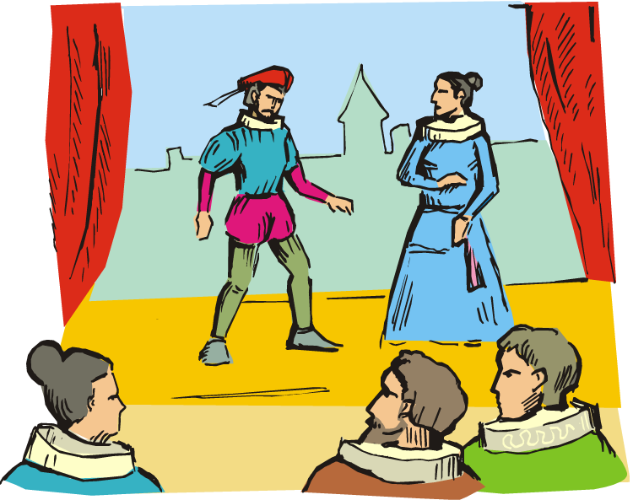

Acts and Scenes
Plays are divided into acts, much like the chapters in a book. They are short performances that are part of a longer story. A lot of things happen in an act so writers break the acts down into scenes.
The scenes within the act help to break down the story into even smaller pieces so that the entire performance is easier to understand.
Act 1 scene 2

Slide 18
Objectives
1. Distinguish the play’s genre
2. Identify the theme of The Tragedy of Romeo and Juliet
3. Identify the settings in the play
Bloom’s: knowledge, comprehension, analysis

Slide 19
Comprehension Check
Directions: select the best answer to each question.
1. In what year was the Globe Theater was built?
a) 1599 b) 1609 c) 1799
a) 1599
2. What color flag represented a comedy?
a) black b) red c) white
c) white
3. Stage directions are usually written in
a) bold b) red c) italics or brackets
c) italics or brackets

Slide 20


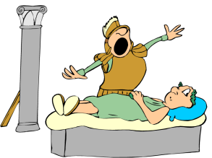
Genre
The play is considered a tragedy: a
genre, or kind of literature in
which the main character suffers
great sorrow or is brought to ruin.
A tragedy is usually the
consequence of a person’s tragic
flaw, moral weakness, or an
inability to cope with a bad
situation.
In a tragedy, the ending is unhappy,
yet has purpose or meaning. There
is a lesson to learn from the events
in the story.
Can you think of any character in the books you have read who might have had a tragic flaw?
…and the moral of the story is?
While reading, try to identify some of the lessons Shakespeare was trying to teach.

Slide 21

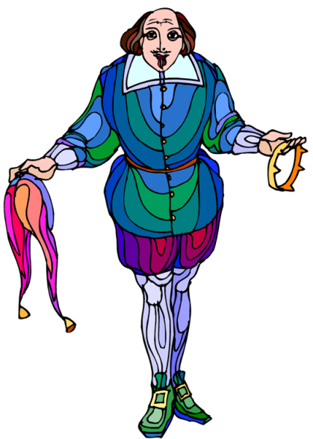
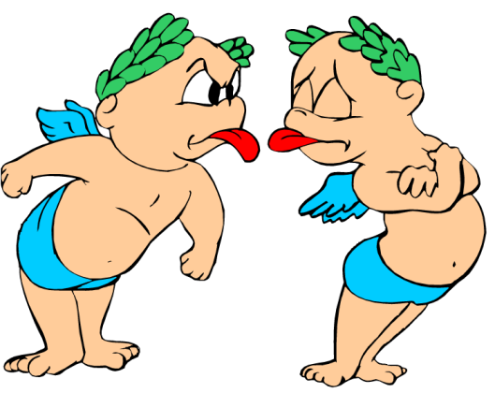
Theme
A theme is the main idea of the story, or the message the author wants the reader to understand. The message is usually about life, society or human nature.
In The Tragedy of Romeo and Juliet, there are many themes… Shakespeare wanted the reader to understand a lot about people.
While there are many themes in the play, love, hate, and fate play important roles.
love
fate
hate

Slide 22


Tragedy, Romance & Humor
Romeo and Juliet is a tragedy which means sad things happen. The play is about love and death.
You’ll find romance in the play… watch out for Romeo, he really knows how to get a girl’s attention.
The play has humor in it, too. Romeo and his friends joke around with one another.
Juliet’s nurse is a funny character; be sure to reread her lines.
Many people cry at the end of the play because the main characters die.
Rapunzel, Rapunzel, let down your golden hair… Oops, wrong story!
Knock, knock…

Slide 23
The Setting
The setting is the time, the
place, and the social environment
that surrounds the characters.
The setting is identified by
observing what the characters
see, hear, feel, etc.
The setting is important because
it often creates the mood of the
story as well as gives hints about
what may happen.
Let’s get started looking at the
setting of Romeo and Juliet.
The time period is the 13th or
14th century in Italy. Both
parents are rich; they dress in
fancy clothes and have many
servants.
Now that you know this, let’s
look at other setting details.

Slide 24
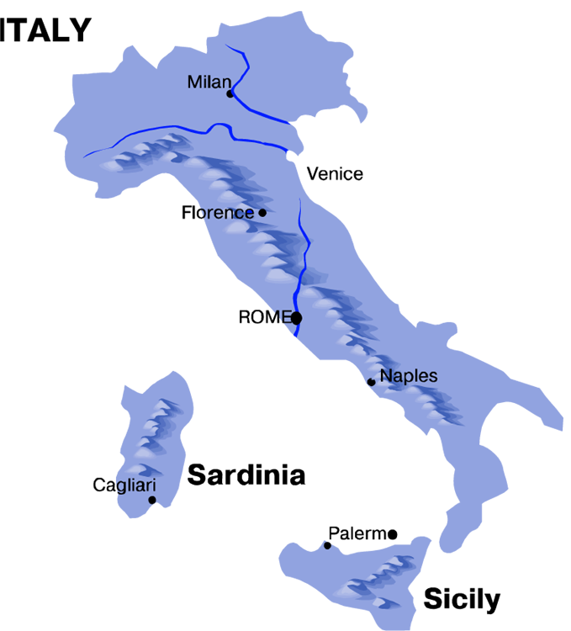
Verona, Italy
Romeo and Juliet lived in Verona with their families.
Today, because of the popularity of William Shakespeare’s The Tragedy of Romeo and Juliet, many tourists come to Verona to see the Casa di Giulietta or The House of Juliet. No one really knows if this was Juliet’s house, but a statue of Juliet stands in the courtyard.
Verona

Slide 25
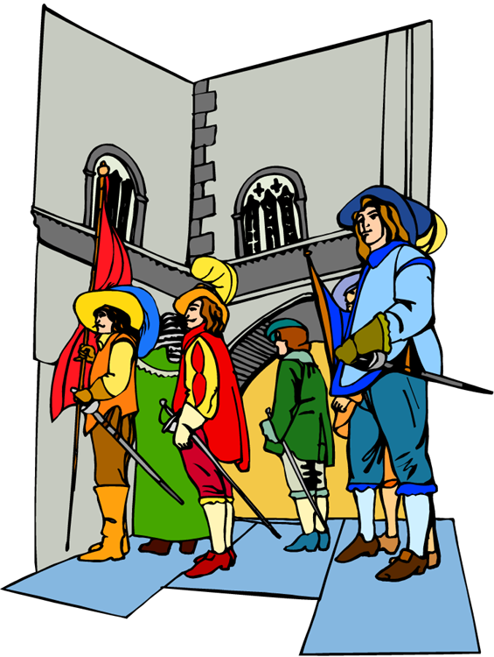
The Streets of Verona
Many of the characters in the play fight in the streets of Verona. In fact, a lot of fighting takes place there.
In spite of its medieval churches and ancient squares, today’s Verona is quite a modern and industrial city.

Slide 26
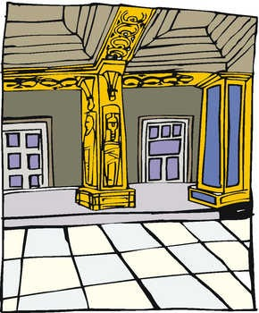

The Capulet Home
Another place where a lot of
action takes place is inside Juliet’s
home.
The masquerade ball (at the
beginning of the play) is in Juliet’s
home.
The famous balcony scene takes
place outside Juliet’s bedroom.
Juliet’s parents were quite wealthy. Their home was more like a manor or small palace.
Juliet’s father loved to show off his money, but only to family members.
Juliet’s bedroom was so huge it had its own balcony!

Slide 27
Comprehension Check
Directions: select the best answer to each question
1. Plays were meant to be
a) watched b) read c) watched and read
a) watched
2. In what city do Romeo and Juliet live with their parents?
a) Stratford b) Verona c) Capulet
b) Verona
3. Where and when the story takes place is
a) the story b) the setting c) the author
b) the setting

Slide 28
Objectives
1. Identify literary elements
2. Examine the structure
of a Shakespearean tragedy
Bloom’s: knowledge, comprehension, analysis

Slide 29
Soliloquies and Asides
Sometimes in a play characters talk to themselves out loud and some talk for quite a long time. When characters do this, it is called a soliloquy.
Shakespeare often uses the soliloquy in his plays to let a character to express their private thoughts and feelings. These speeches are performed when the character is alone on the stage. Soliloquies are a way for the audience to connect and better understand that character.
Like the soliloquy, the aside is on stage, but away from the other characters. The actor either speaks an aside to himself or secretively to another character. Sometimes the actor speaks directly to the audience. A clever device really!

Slide 30
Blank Verse
Blank verse is poetry that doesn’t rhyme. It is written in iambic pentameter. For example:
“They are the fact ion O con spir a cy
Sham’st thou to show thy dang’ rous brow by night”
(2.1.77-79).
.
.
.
.
.
.
.
.
.
.
Aristocratic and or important people typically speak in blank verse.
Iambic pentameter is when an unstressed syllable is followed by a stressed syllable.
Pentameter means the iambic pattern is repeated five times in the line.

Slide 31

Foreshadowing
Foreshadowing:
hints about what is going to happen
It isn’t difficult to figure out what
is going to happen to Romeo and
Juliet. After all, the prologue tells us that the “star-crossed lovers take their life” (Shakespeare).
While reading the play, there are many hints or clues that support the prologue.
Put your detective skills to work;
look for these clues while reading the play.

Slide 32
Foreshadowing
How Shakespeare Designed His Plays
Shakespeare’s plays can usually be divided into five parts, and follow the same pattern that looks something like this:
ACT III
Turning Point
ACT II
Rising Action
ACT IV
Falling Action
ACT I
Exposition
ACT V
Climax & Resolution

Slide 33
Foreshadowing
How Shakespeare Designed His Plays
The turning point of
the story is when the main
character makes a choice. This
choice determines if the ending
will be happy or sad.
Rising action is when the
main character takes action
to try and resolve the problem
in ACT I
The falling action is the event/s
that are a result of the choice
made at the turning point.
The character falls deeper
into tragedy.
The exposition tells us the
setting, explains the background,
introduces the characters, and
introduces the problem.
The climax, or when the reader knows
who wins the conflict, is at the end of
the story. Usually the main characters
die. Resolution occurs and the
unfinished parts of the play are resolved.

Slide 34
Comprehension Check
Directions: select the best answer to each question
1. Foreshadowing hints about what is
a) watched b) about to be read c) about to happen
c) about to happen
2. Shakespeare’s plays can usually be divided into _____ parts
a) 5 b) 4 c) 3
a) 5
3. The resolution occurs when the unfinished parts of the play are
a) started b) resolved c) nurtured
b) resolved

Slide 35
Objectives
1. Identify the characters in the story
Bloom’s: knowledge, comprehension

Slide 36
The Characters
Characters are the people in the story. There are many different kinds of characters in a story, just like there are many different people in the world.
An antagonist is
a person or thing
that is against
the protagonist.
A protagonist is
a main character
who is a
“good” person.
Antagonist
Protagonist

Slide 37
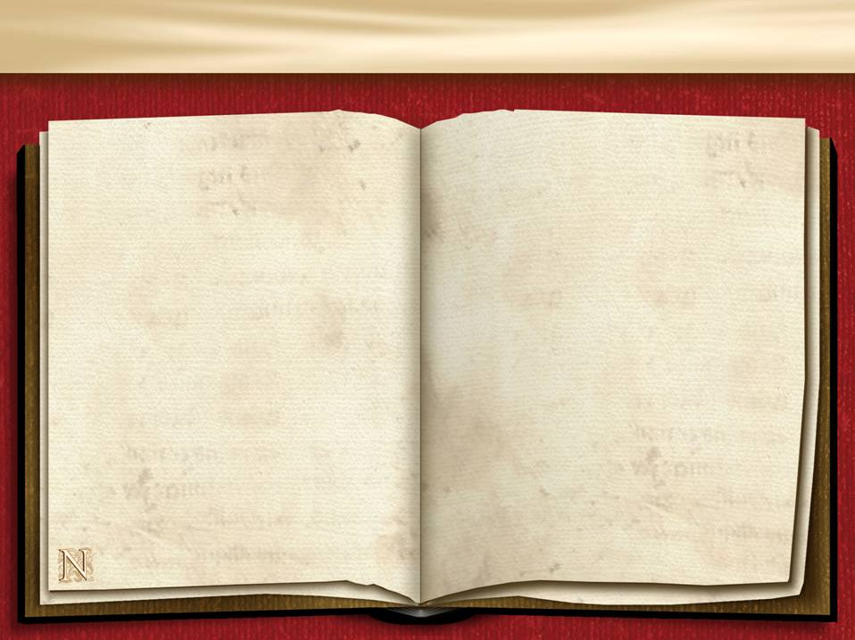
Who’s Who in the Play
Characters are the people in the story. There are many different kinds of characters in a story, just as there are many different people in the world.
The Capulets
Lord and Lady Capulet are Juliet’s parents. They were a noble family, which meant they were wealthy and important in Verona’s society. The Capulets were ruthless and liked things to be done their way.
The Montagues
Lord and Lady Montague are Romeo’s parents. They were a noble family, and one of the richest and most powerful families in Verona’s society. The Montagues were nice, but looked down on the Capulets.

Slide 38

The Characters
These two are the most important characters in the novel.
Romeo
Juliet
Romeo is the main character in the play who is full of passion and romantic feelings. He rushes into things before thinking them through.
Juliet is also a main character in the play. She is only 13, but does not act like a child. A very strong-willed character, Juliet and falls for Romeo instantly.

Slide 39
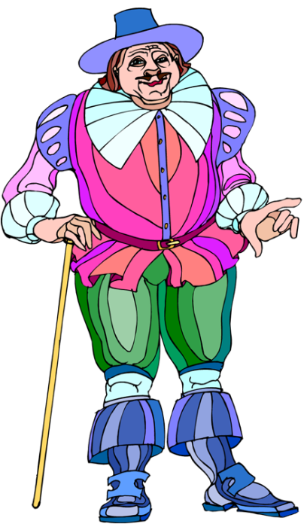
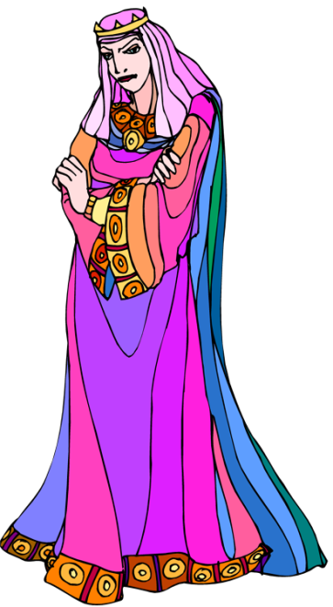
The Characters
Lord Capulet
Lady Capulet
Lord Capulet is Juliet’s father and an influential member of Verona’s society. He loves his daughter, Juliet, but demands her obedience.
Lady Capulet is Juliet’s mother, and also influential in Verona’s society. However, Lady Capulet is ambitious. In order for her to move up in Verona’s society, Lady Capulet wants Juliet to marry a wealthy man.

Slide 40
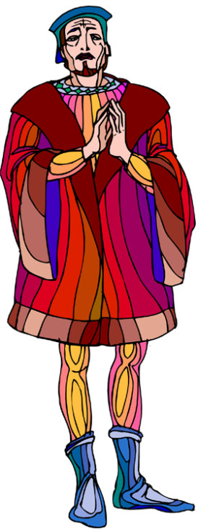
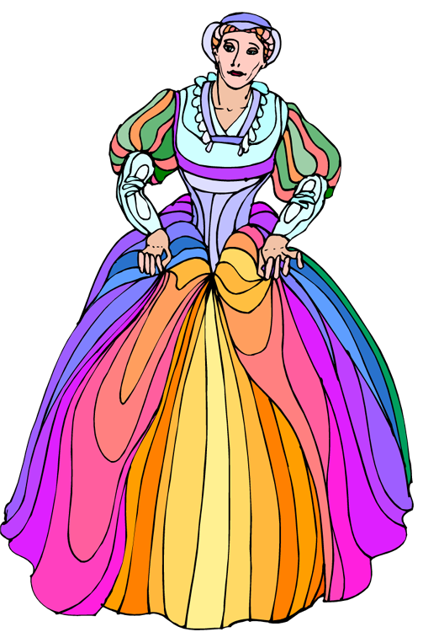
The Characters
Lord Montague
Lady Montague
Lord Montague is Romeo’s father, wealthy and important, he loves his son and is worried about Romeo’s happiness.
Lady Montague is Romeo’s mother. She is a very kind, but an emotional, woman who loves her son and husband.

Slide 41
The Characters
Benvolio
Mercutio
Benvolio is Romeo’s cousin and friend. He is the peacemaker in the play and tries to stop every fight that is started.
Mercutio is Romeo’s best friend. He is a bit of a jokester, and always teases other characters in the play. Unfortunately, Mercutio’s teasing angers the wrong person.

Slide 42
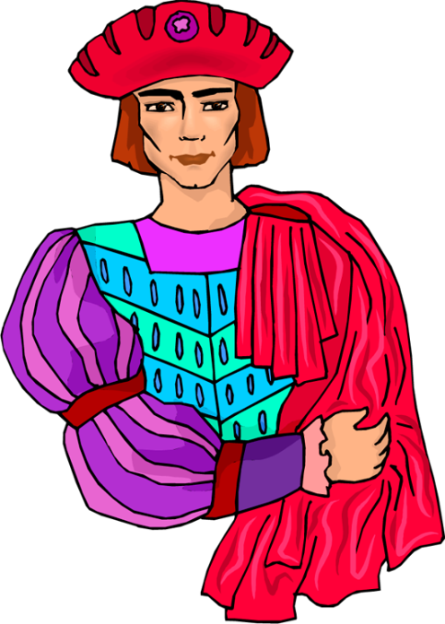
The Characters
Tybalt
Prince Escalus
Tybalt is Juliet’s cousin. He is a real hot—head who fights just about everyone in the play. Tybalt thinks he is fighting for the honor of his family.
The prince rules Verona. He is the head of Verona’s courts who makes sure both the Capulets and Montagues keep the peace.

Slide 43
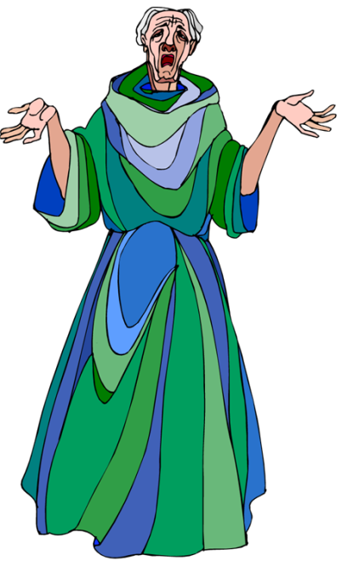
The Characters
The Nurse
Friar Lawrence
The nurse is Juliet’s nanny. She is a real character who loves and cares for Juliet as if Juliet were her own daughter.
The friar is Romeo’s counselor and friend. He is good and kind, and hopes that, by marrying Romeo to Juliet, the long time family feud will end.

Slide 44
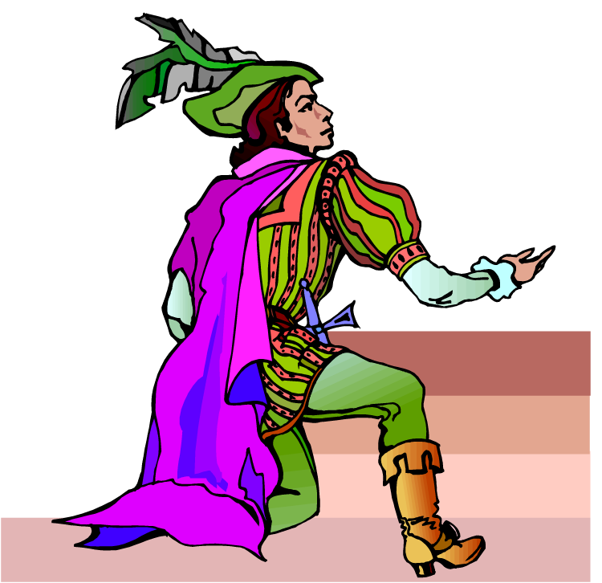
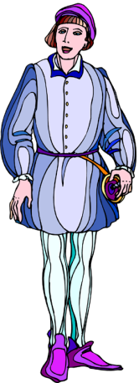
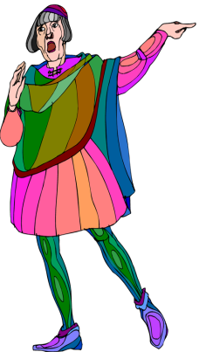
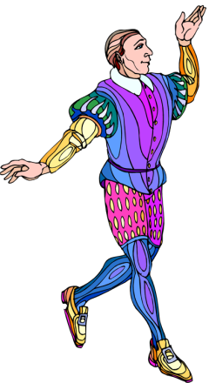
The Characters
The County Paris
The Servants
The County Paris is a count– an important nobleman. He is related to the Prince and has asked Juliet’s father for Juliet’s hand in marriage.
The servants serve both the Capulets and the Montagues. They help to spark the feud between the Capulets and the Montagues.

